Slide 1
Office Solutions Development
Topic 3:
An Introduction to the Advanced Features and Functions of the Microsoft Office Suite
Notes:
NCC Education - Title Master

Slide 2
Scope and Coverage
This topic will cover:
  The advanced features and functions of the Microsoft Office Suite
Notes:
NCC Education - Slide Master

Slide 3
Learning Outcomes - 1
By the end of this topic, students will be able to:
  Explain what applications are available in the Microsoft Office Suite
  Describe what advanced features and functions are available in various applications
  Describe how these features and functions improve business performance

Slide 4
Learning Outcomes - 2
By the end of this topic, students will be able to:
  Evaluate if the features and functions of the application software discussed address both user and business requirements
  Evaluate whether interface design principles have been applied when using these functions

Slide 5
Terminology
  Terminology will be explained in the lecture, tutorial and laboratory session. You should take notes!
  Ask questions if you do not understand.

Slide 6
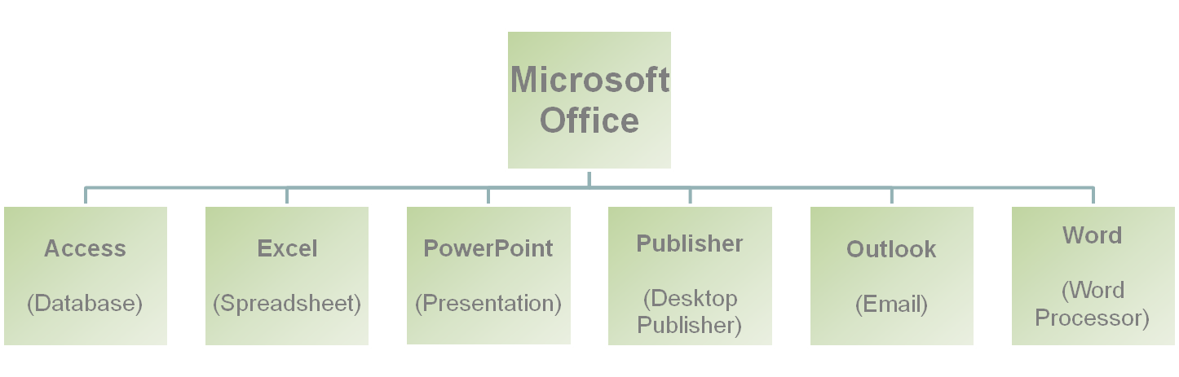
An Introduction to the Microsoft Office Suite
  The Microsoft Office Suite is an example of integrated application software; it contains several applications and the main ones are:

Slide 7
Versions of Microsoft Office
  First released in 1990, it has undergone many changes
  Office 2003 is still used by many organisations.
  There were changes to the interface in Office 2007 and Office 2010; a new Fluent User Interface has been introduced that replaces the menus and toolbars of the 2003 version with a toolbar of tabs called a Ribbon.
  There are four versions of Office 2010 and only one version contains Access (Microsoft Office Professional Plus 2010).

Slide 8
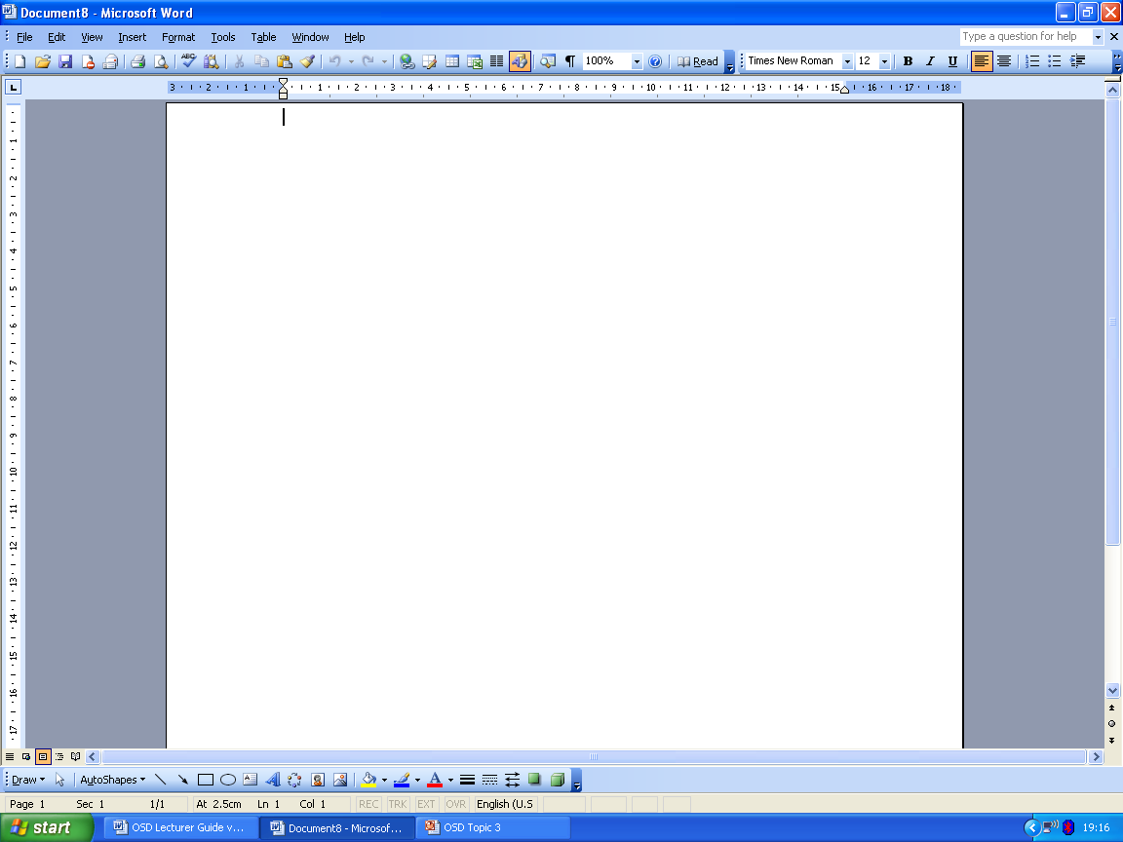
The 2003 Interface
Menus, tool bar, ruler

Slide 9
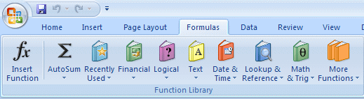
The Ribbon Interface
Tabs
Office
button

Slide 10
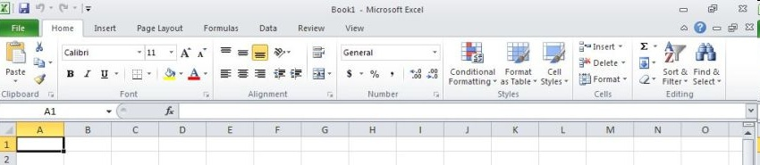
Excel Ribbon

Slide 11
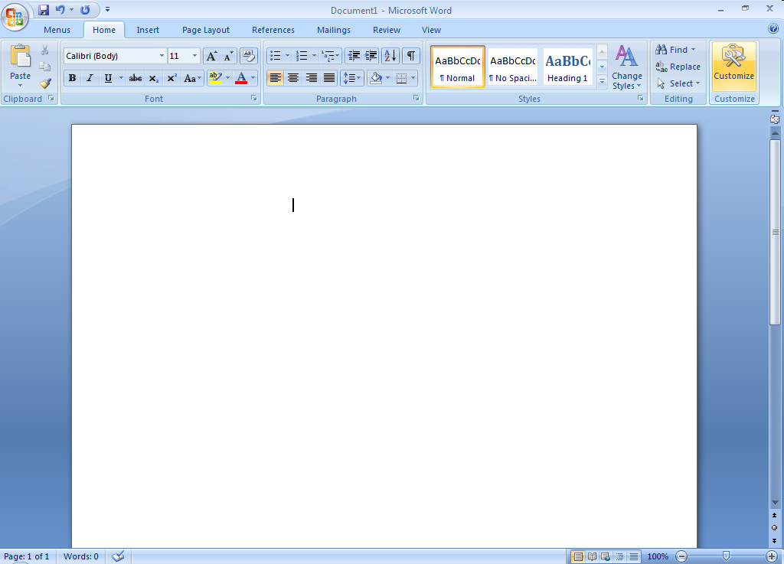
Word Ribbon

Slide 12
Advanced Features and Functions
  These are offered as part of the 2003, 2007 and 2010 suites:
    advanced queries
    templates
    functions
    pivot tables and charts
    conditional formatting
    validation
    macros and VBA
    user-level security

Slide 13
Advanced Queries
  They allow complex searches of data.
  They can involve the use of a dedicated structured query language.
  They enable specific criteria to be asked.

Slide 14
Templates
  A template is a document in which some parts are already created such as the layout, fonts, margins, and other features.
  They include word processed letters and invoices, spreadsheet worksheets, database reports.

Slide 15
Functions
  Excel functions include:
    financial functions (e.g. work out monthly payments on loans using the PMT function)
    date and time functions (dynamic and static)
    logical functions (evaluate conditions using IF statements)
    statistical functions (SUM, AVERAGE, COUNT, MAX, MIN, MEDIAN)
    lookup functions (look for data)
    text functions (enable text entries in cells)

Slide 16
Pivot Tables and Charts
  Can be used to analyse and summarise data from large amounts of information
  Can be used to create reports from the data that is extracted from the analysis
  The position of the fields in a table can be rearranged to provide the user with a different view that makes the data easier to read.
  You will create and use this feature in Topic 4.

Slide 17
Conditional Formatting
  Allows a user to change the formatting of a cell based on the values that are in it, e.g. a list of customers contains details of the amount of money customers have spent on products and some customers have spent over £200. These amounts should be displayed in green.
  The cell automatically formats itself based on its value, so if a user changes the value, it can change its formatting.
  If £200 or more has been spent, the figure will be displayed in green. The condition refers to the amount and the formatting refers to the colour.

Slide 18
Validation
  Enables data entry to be completed efficiently, accurately and quickly
  Invalid data can include: text entered into an integer cell, a decimal entered into a date cell, etc.
  It can be done by creating:
    a data entry form
    a check box
    a combo box
    creating input messages
    creating error alerts

Slide 19
User-Level Security
  Users can administer access rights to other users, deciding on how much access to give them, e.g. allowing them to only view data
  This includes setting password controls.

Slide 20
How Advanced Features and Functions Improve Business Performance
  Make tasks easier to perform, e.g. automation, validation
  Improve the overall performance of the application, e.g. automation
  Improve the accuracy of data management, e.g. validation
  Increase productivity, e.g. data entry, functions
  Increase security, e.g. access controls

Slide 21
Business Processes that are Improved by Advanced Features and Functions
  Office Automation
  Decision Support
  Information Management and Retrieval

Slide 22
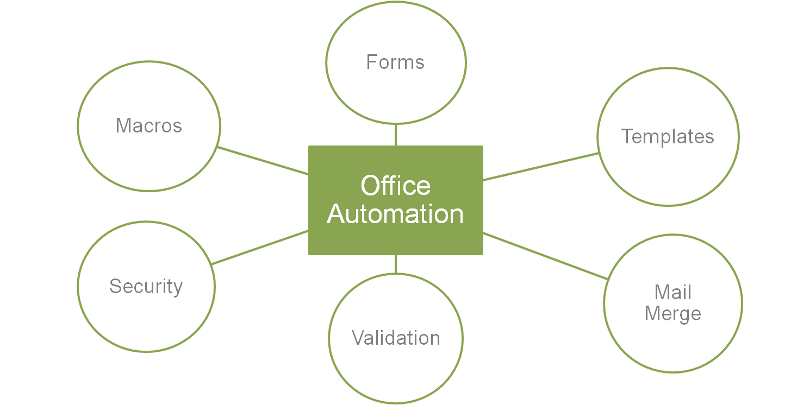
Advanced Features and Functions - 1

Slide 23
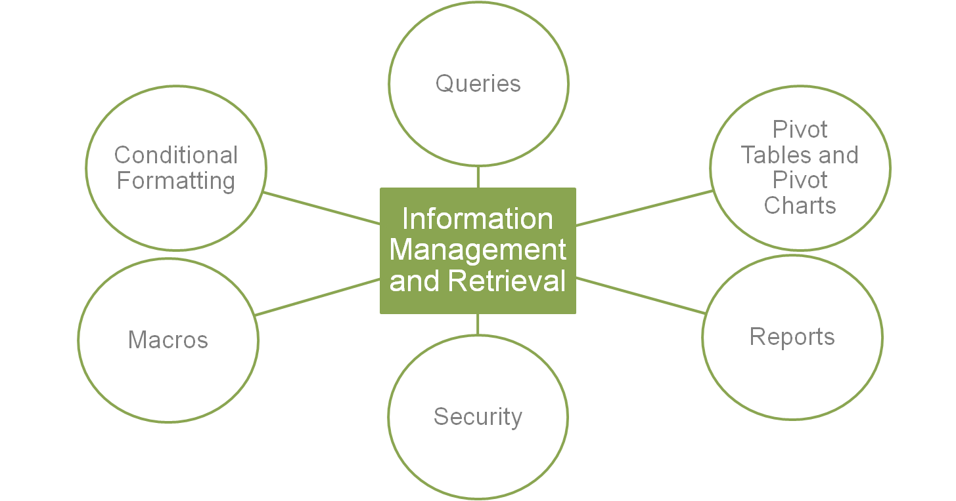
Advanced Features and Functions -2

Slide 24
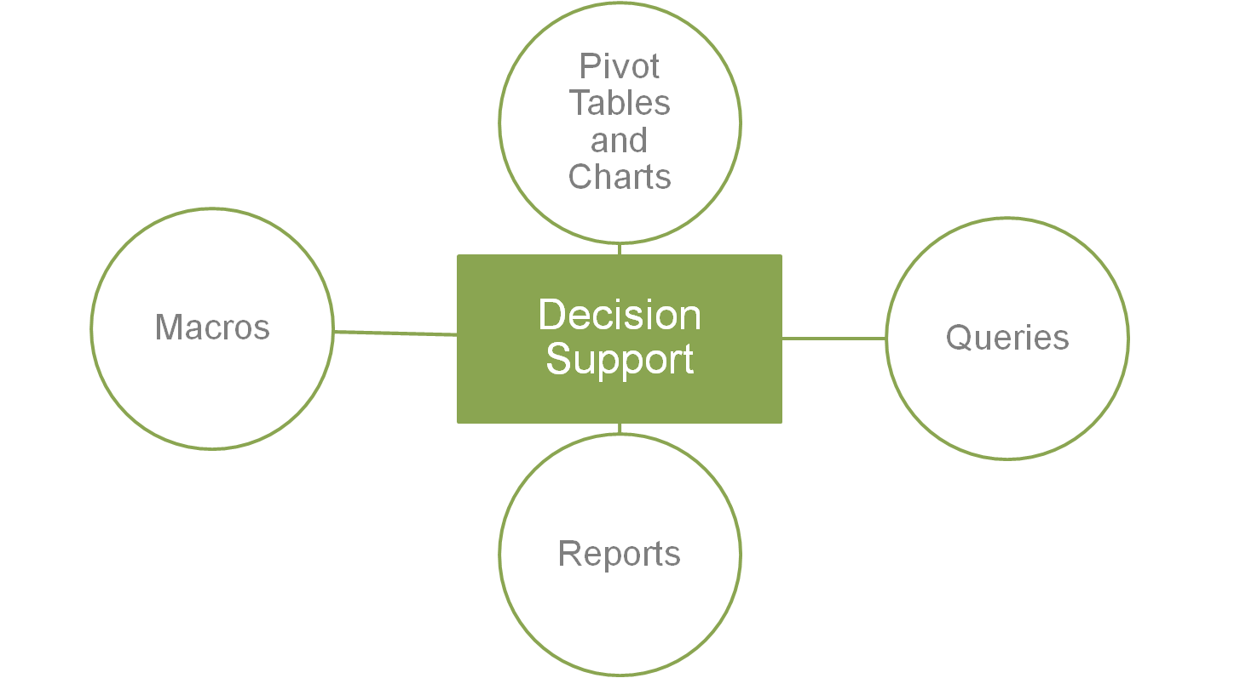
Advanced Features and Functions - 3

Slide 25
Access, Excel and Word
  We will concentrate on the advanced features and functions of Access, Excel and Word and look at them in greater detail in Topics 4-9.

Slide 26
Access Advanced Features and Functions
  In order to store, retrieve, manage and analyse data quickly and effectively, the following can be used:
    Advanced queries
    Forms
    Templates
    Automating with macros
    User-level security

Slide 27
Excel Advanced Features and Functions
  Templates
  Conditional formatting
  Validation
  Functions
  Pivot tables and charts
  Automating with macros
  User-level security

Slide 28
Word Advanced Features and Functions
  Templates
  Mail merge
  Automating with macros
  User-level Security

Slide 29
Using the Advanced Features and Functions
  You will create and use each of the Access, Excel and Word features and functions in Topics 4-9.

Slide 30
References
  Jaxworks Small Business Spreadsheets Factory. (2010). [Available Online]
    http://www.jaxworks.com
  Microsoft Office
    http://office.microsoft.com

Slide 31
Topic 3 – An Introduction to the Advanced Features and Functions of the Microsoft Office Suite
Any Questions?
Notes:
NCC Education - End Slide Master

